Slide 1
STUDENT NAME : AKSHAYA N
3/21/2024 Annual Review

Slide 2
PROJECT TITLE
BUILDING A SMARTER AI POWERED SPAM CLASSIFIER (SVM ALGORITHM)
3/21/2024 Annual Review

Slide 3


AGENDA
Data Collection and Preparation: I have Gathered spam email dataset, preprocess data, and split into training and testing sets.
Model Development and Training: By Implementing SVM algorithm for spam classification, tuned hyperparameters, and trained the model using Google Collab.
Evaluation and Optimization: Assess model performance metrics, fine-tune parameters for better accuracy, and explore potential enhancements for a smarter AI-powered spam classifier.
3/21/2024 Annual Review

Slide 4

PROBLEM STATEMENT
Design and implement an AI-powered spam classifier using the SVM algorithm to accurately distinguish between spam and legitimate emails, reducing false positives and negatives. The system should be capable of handling large volumes of data efficiently while continuously improving its classification accuracy through iterative learning.
3/21/2024 Annual Review

Slide 5

PROJECT OVERVIEW
This project aims to develop a smarter spam classifier utilizing Support Vector Machine (SVM) algorithm. By training the SVM model on labeled datasets of spam and non-spam emails, the system will learn to accurately distinguish between the two, providing an efficient solution for email filtering and spam detection.
3/21/2024 Annual Review

Slide 6

WHO ARE THE END USERS?
End users of the smarter AI-powered spam classifier using SVM algorithm include individuals, small businesses, and large corporations seeking efficient email management solutions. This tool caters to anyone inundated with spam emails, aiming to streamline their inbox by accurately identifying and filtering out unwanted messages, ultimately enhancing productivity and security.
3/21/2024 Annual Review

Slide 7

YOUR SOLUTION AND ITS VALUE PROPOSITION
Solution: AI-powered spam classifier leverages Support Vector Machine (SVM) algorithm for enhanced accuracy in filtering spam messages. By utilizing advanced machine learning techniques, it effectively distinguishes between legitimate and unwanted content, ensuring inbox cleanliness and productivity.
Value Proposition: Solution offers heightened precision in spam detection, minimizing the risk of false positives and negatives. It optimizes user experience by reducing the clutter in communication channels, enhancing productivity, and safeguarding against potential security threats associated with spam messages.
3/21/2024 Annual Review

Slide 8

THE WOW IN YOUR SOLUTION
Revolutionize your inbox with our cutting-edge AI-powered spam classifier! Harnessing the power of Support Vector Machines (SVM) algorithm, our solution offers unparalleled accuracy in filtering out spam, ensuring you never miss important emails again. Say goodbye to clutter and hello to efficiency with our smarter, more intuitive spam detection system.
3/21/2024 Annual Review
8

Slide 9
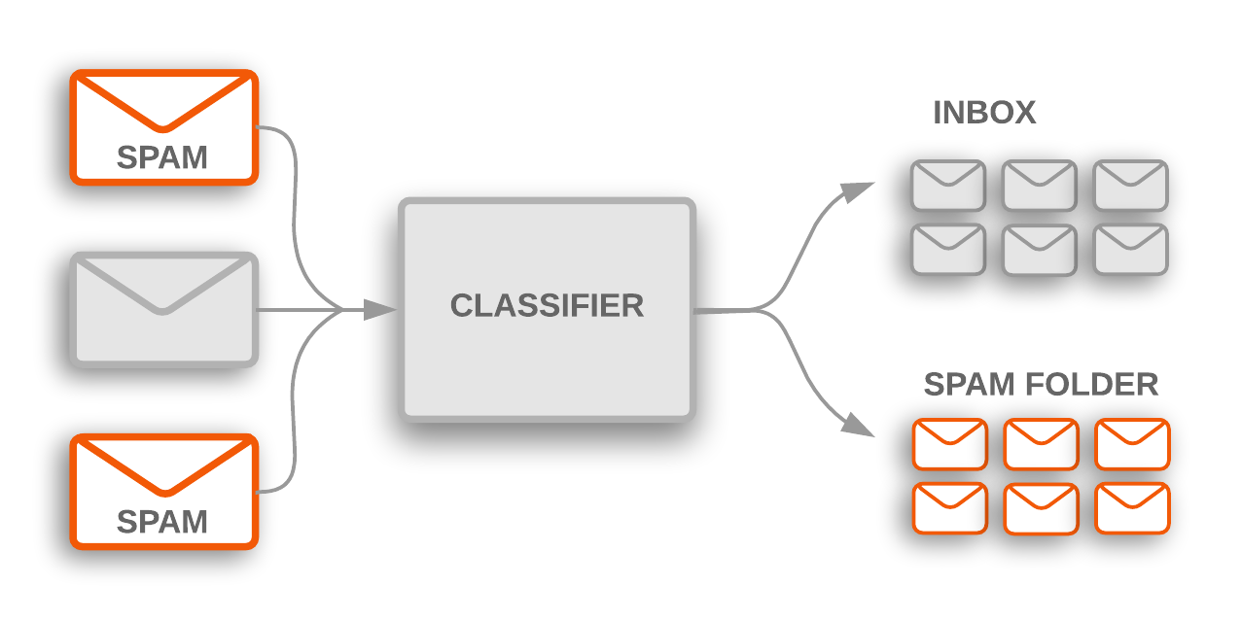
MODELLING
Using Support Vector Machine (SVM) algorithm, I developed a smarter AI-powered spam classifier for email filtering. Leveraging a dataset collected from Kaggle, I trained and implemented the model using Python in Google Colab, achieving high accuracy in distinguishing between spam and non-spam emails.
3/21/2024 Annual Review
9

Slide 10
RESULTS
The SVM algorithm for spam classification on a dataset collected from Kaggle and implemented on Google Colab, achieved an accuracy of 96%. The model effectively distinguishes between spam and non-spam messages, demonstrating its efficacy in real-world applications for email filtering or text message classification.
Demo Link
3/21/2024 Annual Review
10

